Slide 1
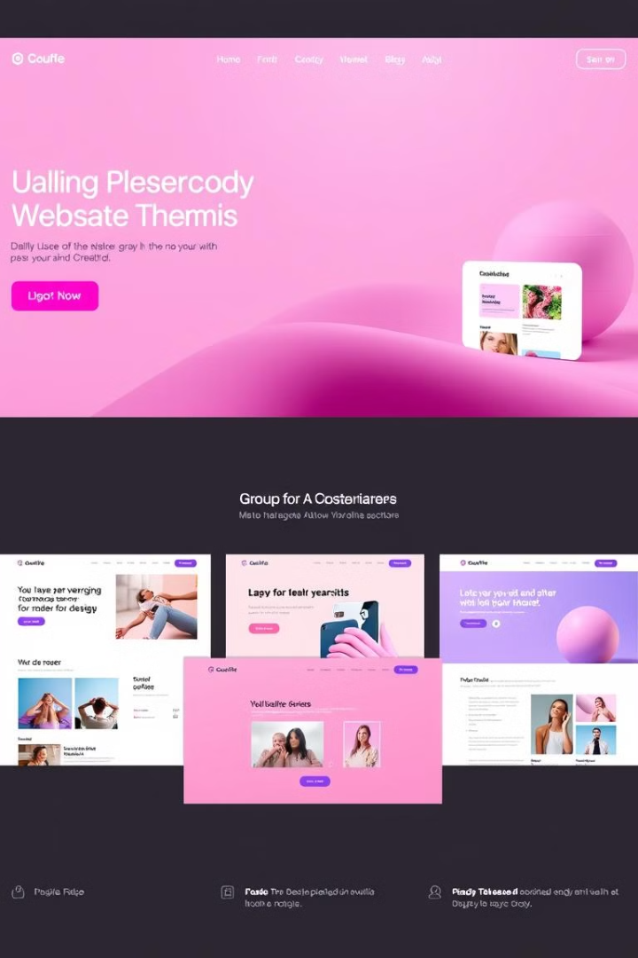
WordPress Themes: Building Your Website's Foundation
Welcome to the world of WordPress themes! This presentation will guide you through the basics. Learn how themes shape your website's look and feel. Discover customization options and find the perfect theme for your needs.

Slide 2
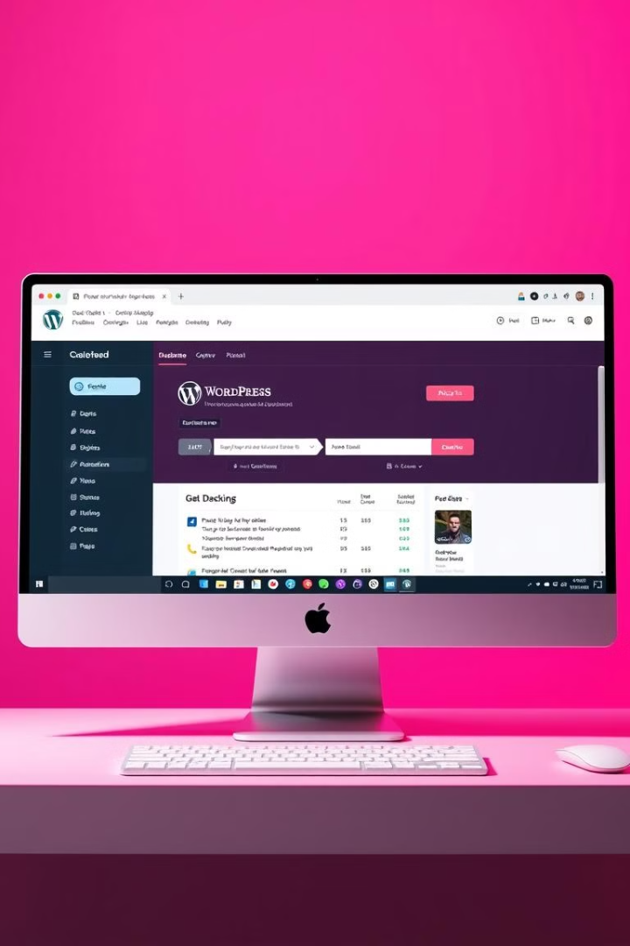
What is WordPress and Why Use It?
WordPress is a powerful content management system (CMS). It allows users to create and manage websites easily.
WordPress is open-source, flexible, and versatile. It's suitable for blogs, businesses, and e-commerce sites.
Easy to use interface for content creation.
Large community and extensive plugin library.
Themes offer design and functionality control.

Slide 3
What is WordPress and Why Use It?
Content Management
User-Friendly
Extensible
WordPress is a powerful content management system (CMS). It simplifies website creation and management.
Its intuitive interface makes it accessible to beginners. No coding knowledge is required to get started.
WordPress is highly customizable with themes and plugins. Extend functionality to meet specific needs.

Slide 4
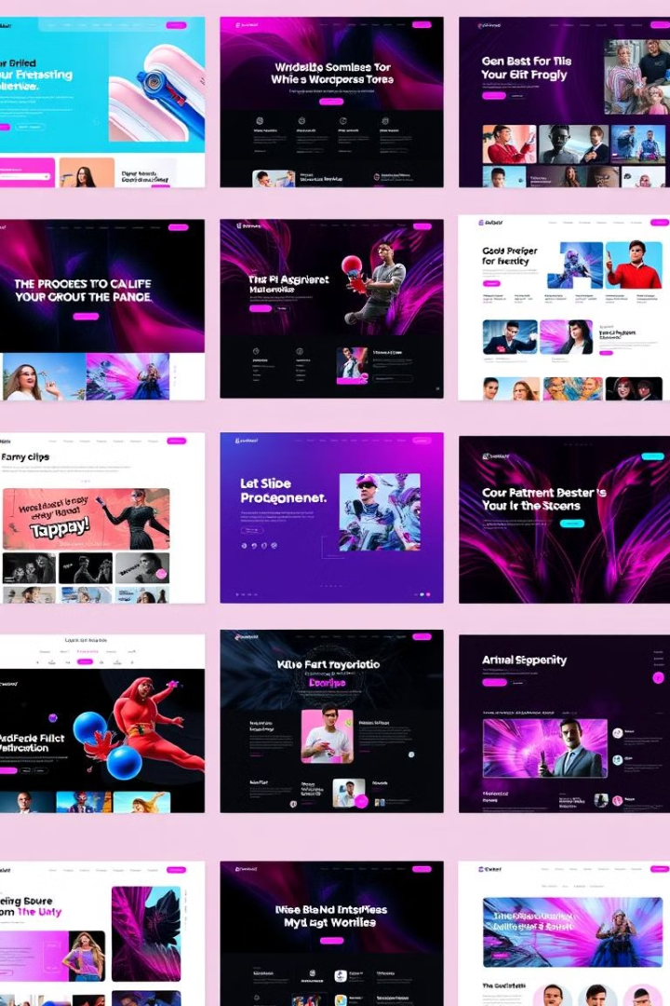
Understanding Themes: Design and Functionality
Visual Layout
Functional Features
Themes control your website's overall visual design. They determine the layout, colors, and typography.
Themes can also provide specific functionalities. These include blog layouts, portfolio display, and e-commerce integration.
Customization Options
Most themes offer customization options. This allows you to tailor the design to match your brand.

Slide 5

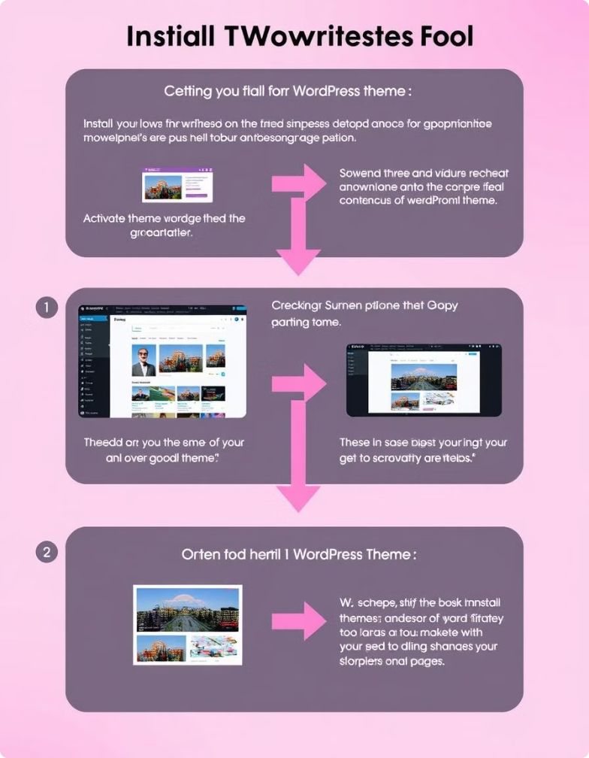




Installing and Activating a Theme: Step-by-Step
Access Dashboard
Log in to your WordPress dashboard.
Navigate to Themes
Go to Appearance Themes to select the theme.
Add New Theme
Click "Add New" and search or upload a theme.
Activate Theme
Click "Activate" to apply the theme to your site.

Slide 6
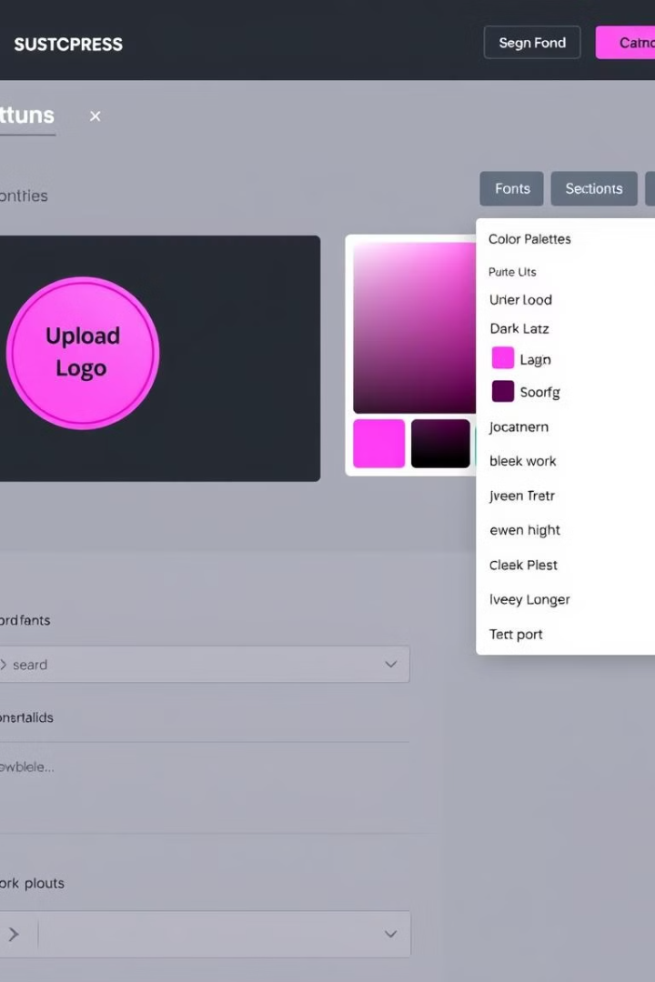



Basic Theme Customization: Logo, Colors, and Fonts
Logo Upload
Color Scheme
Font Selection
Upload your logo to personalize your site.
Adjust the color scheme to match your branding.
Choose fonts that are readable and align with your style.

Slide 7
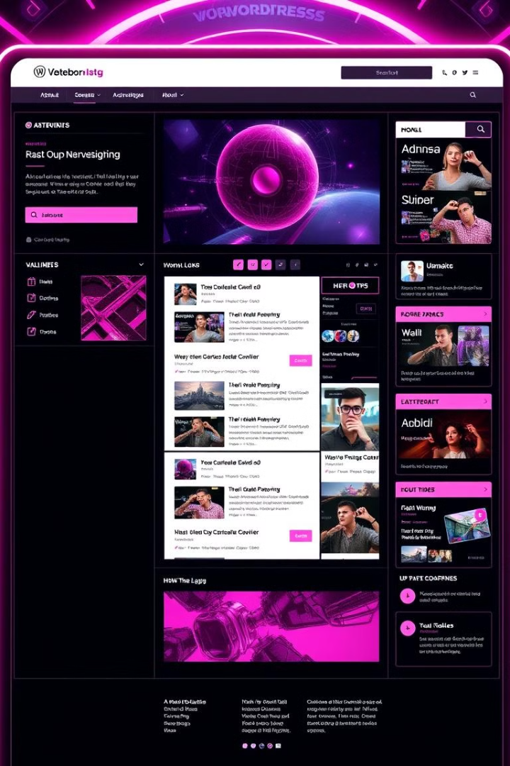
Exploring Theme Options: Widgets and Menus
1
Widgets
2
Menus
Add widgets to sidebars and footers. Display content like recent posts or social media links.
Create navigation menus for easy site browsing. Link to important pages and categories.
3
Customization
Customize widgets and menus to enhance user experience and navigation.

Slide 8
Finding the Right Theme: Free vs. Premium
Free Themes
Premium Themes
Available in the WordPress theme directory. Good for basic websites and blogs. Limited features and support.
Paid themes from marketplaces or developers. More advanced features and dedicated support.

Slide 9
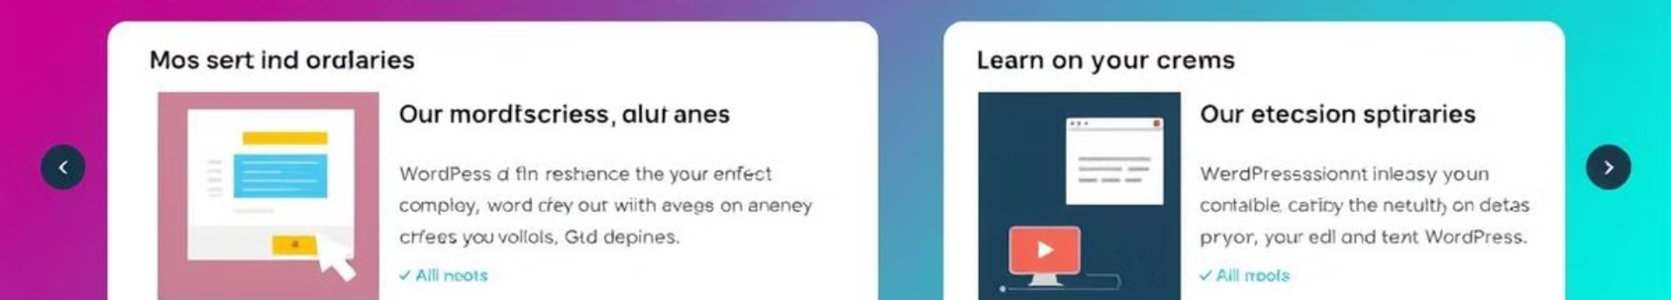
Next Steps: Practice and Further Resources
Experiment
Learn
Install and customize different themes.
Consult online tutorials and documentation.
1
2
3
4
Explore
Create
Visit the WordPress support forums.
Build your unique website!

Slide 10

Thank You and Next Steps
Thank you for learning about WordPress themes! Now it's time to put your knowledge into practice.
Experiment with different themes and customize them. Explore the WordPress community and create your unique website.
1
Explore Further
2
Build and Launch
Delve deeper into advanced theme customization options.
Create your website with a theme that matches your vision.
3
Contribute
Share your experiences and help others in the WordPress community.

